Slide 1
Natural and Social Science Foundations of Political Legitimacy
Acceptance of a given system of governance depends on personal perceptions and attitudes toward risk and whether government agency is preferable to private institutions

Slide 2
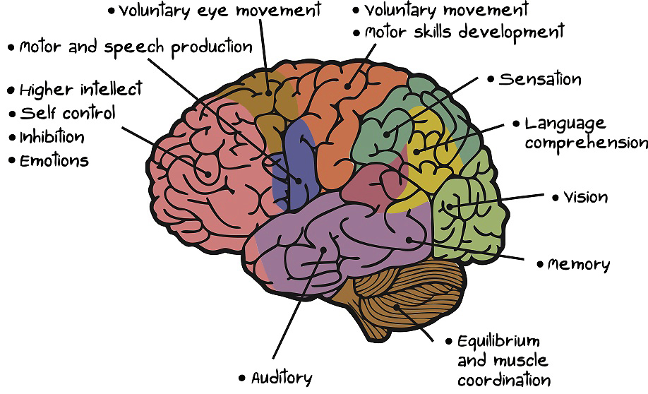
How Does Neuroscience Provide a Roadmap to Human Interactions?

Slide 3
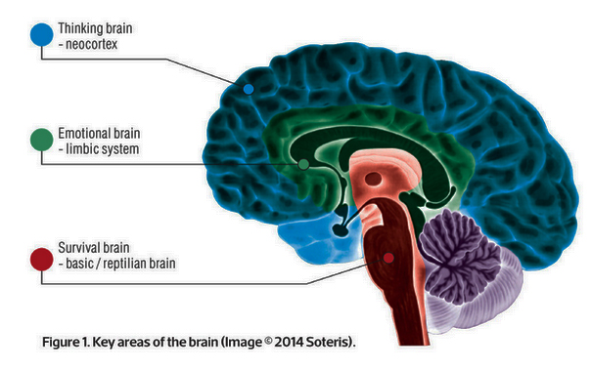
What Are The General Partitions of the Brain?

Slide 4
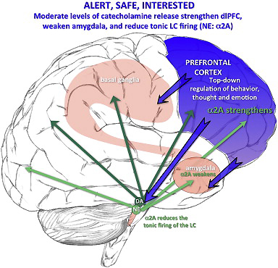
Normal Brain Functioning

Slide 5
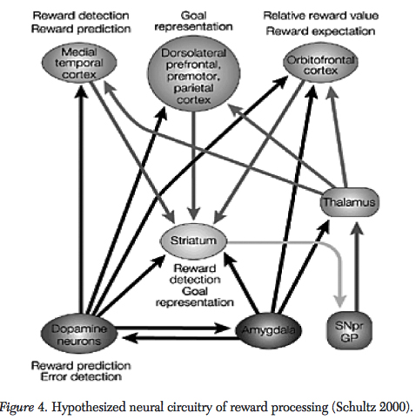
Decision Interactions in the Brain

Slide 6
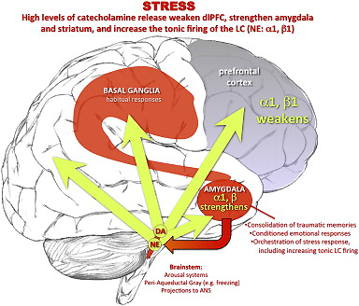
The Brain Under Stress

Slide 7
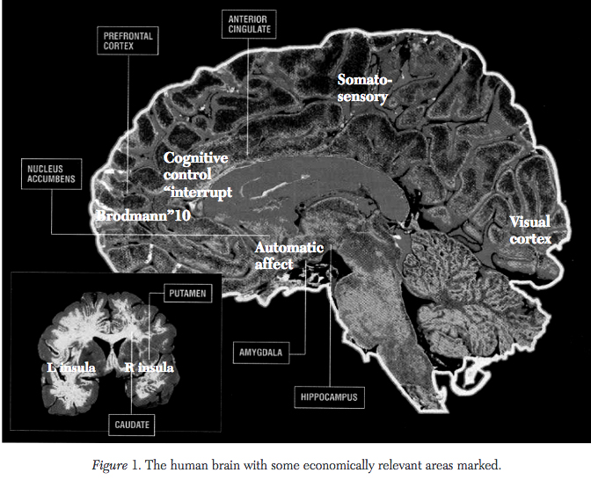
Economic Dimensions of the Brain

Slide 8
Economic Decisions under Classical, Neoclassical, and Post-Modern Formulations
Adam Smith (1723-1790)
David Ricardo (1770-1823)
Karl Marx (1818-1883)
Alfred Marshall (1842-1924)
John Maynard Keynes (1883-1946)
Daniel Bernouilli (1700-1782)
Daniel Kahnemann (1934- ) and Amos Tversky (1937-1996)
Richard Thaler (1945- )

Slide 9
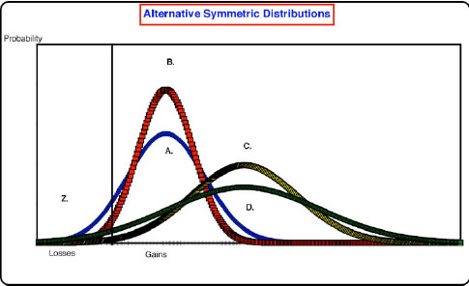
Heterogeneity in Risk Preferences

Slide 10
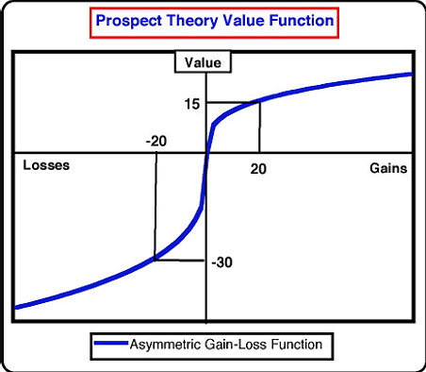
Prospect Theory

Slide 11
Prospect Theory Propositions

Slide 12
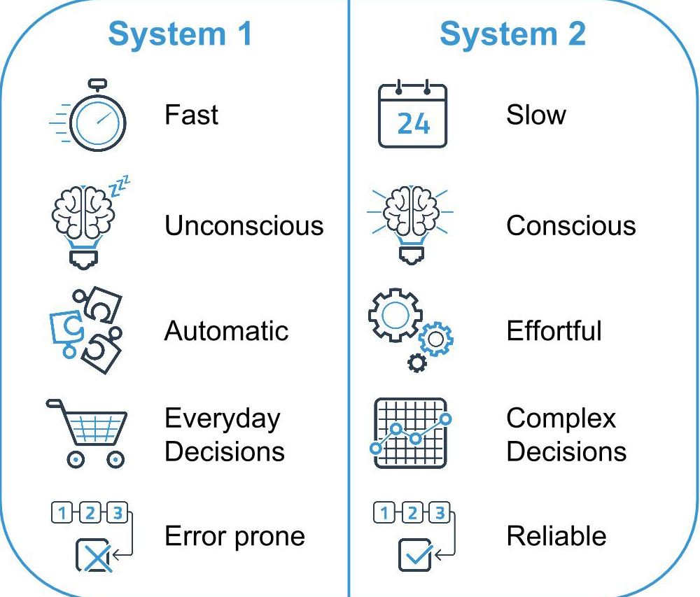
Thinking Fast and Slow

Slide 13
What Do Neuroscience and Behavioral Economics have to do with Political Legitimacy?
Aristotle – Politics (350 BCE)
Machiavelli – The Prince (1513)
Hobbes – Leviathan (1651)
Locke – Second Treatise on Government (1688)
Montesquieu – Spirit of the Laws (1748)
Rousseau – The Social Contract (1762)
Borda – Mémoire sur les élections au scrutin (1781)
Condorcet – Essai sur l’application de l’analyse à la probabilité des décisions rendues à la pluralité des voix (1785)
Bentham – Principles of Morals and Legislation (1788)
Arrow – Social Choice and Individual Values (1951)
Downs – An Economic Theory of Democracy (1957)
Rawls – A Theory of Justice (1971)
Nozick – Anarchy, State, and Utopia (1974)

Slide 14
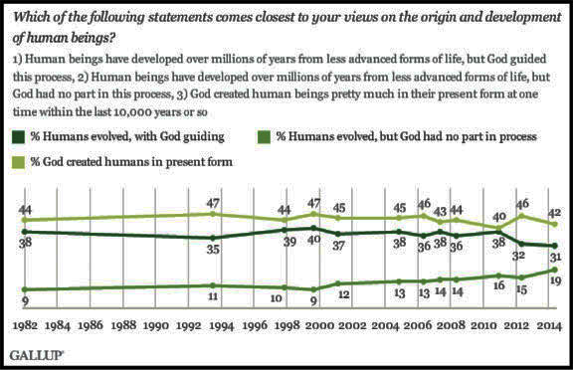
A Sampler of Public Attitudes - 1

Slide 15
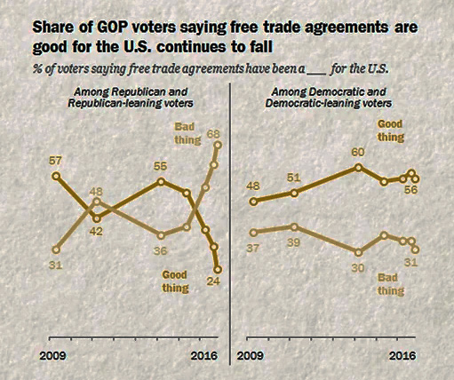
A Sampler of Public Attitudes - 2

Slide 16
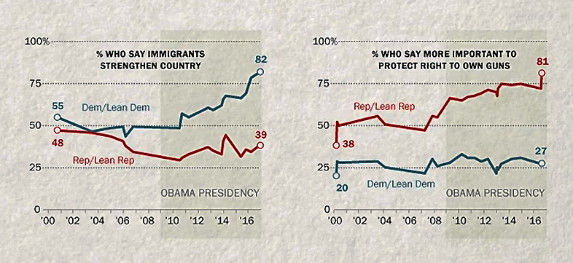
A Sampler of Public Attitudes - 4

Slide 17
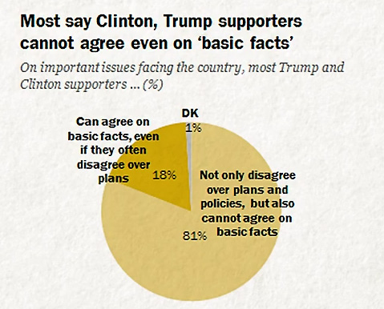
A Sampler of Public Attitudes - 3

Slide 18
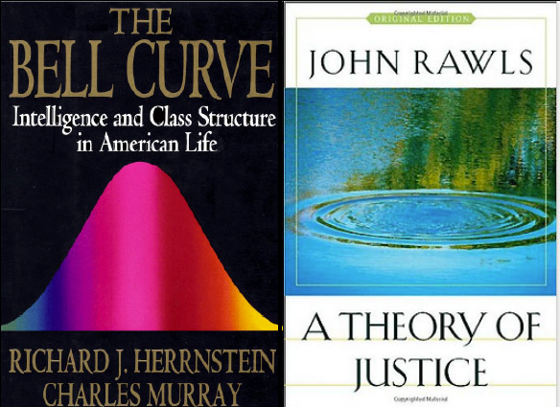
Elitism and Inequality Shape Political Discourse

Slide 19
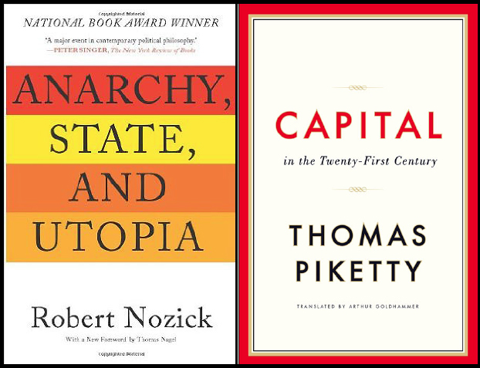
Social Science Informs Political Views

Slide 20
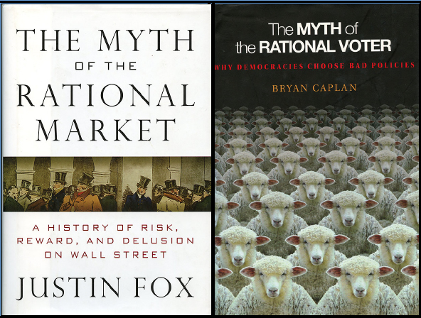
Can Rationality Serve as a Path to Political Legitimacy?

Slide 21
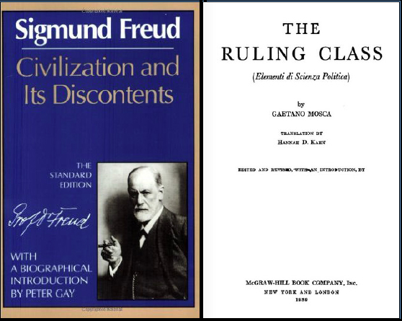
Irrational Decision-Making Can Lead to the Breakdown of Democratic Institutions

Slide 22
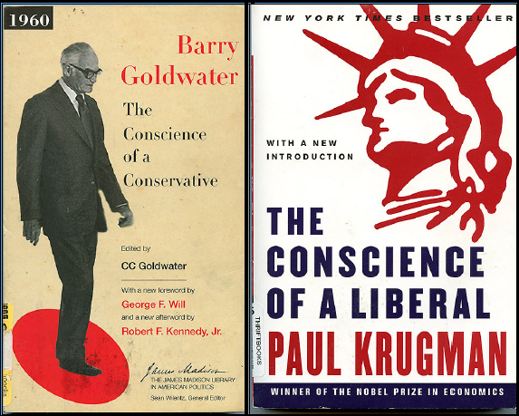
Ideological Differences Shape Political Legitimacy

Slide 23
So What Does This Mean for Political Legitimacy?
Economics, standard and behavioral, looks to scientific explanations and predictions based on rational processing of information
Politics focuses on emotional processing of information
Economics can frame information in a consistent manner but fall short of influencing policy
By appealing to emotions of greed and fear, politics gyrates around a quest for power in which economic rationality may or may not guide economic policy decisions
If the public is susceptible to emotional decisions, it may or may not be rational when it comes to the choice of political regimes

